Slide 1

Customer Segmentation : Case Study
Webinar : Discussion on Approach
October
2018

Slide 2

Problem Statement
Identifying Customer Segments with high likelihood of Conversion for Loan offers

Slide 3
Data Description
Variable | Description
ID | Unique ID (cant be used for predictions)
Gender | Sex of the applicant
DOB | Date of Birth of the applicant
Lead Creation Date | Date on which Lead was created
City Code | Anonymised Code for the City
City Category | Anonymised City Feature
Employer Code | Anonymised Code for the Employer
Employer_Category1 | Anonymised Employer Feature
Employer_Category2 | Anonymised Employer Feature
Monthly Income | Monthly Income in Dollars
Customer Existing Primary Bank Code | Anonymised Customer Bank Code
Variable | Description
Primary Bank Type | Anonymised Bank Feature
Contacted | Contact Verified (Y/N)
Source | Categorical Variable representing source of lead
Source Category | Type of Source
Existing EMI | EMI of Existing Loans in Dollars
Loan Amount | Loan Amount Requested
Loan Period | Loan Period (Years)
Interest Rate | Interest Rate of Submitted Loan Amount
EMI | EMI of Requested Loan Amount in dollars
Var1 | Categorical variable with multiple levels
Approved | (Target) Whether a loan is Approved or not (0/1)

Slide 4

Exploratory Data Analysis
Data Understanding – Univariate Analysis
How well populated is the data?
How much variation is there in the variables given to you?
What is the proportion of missing data for the given raw variables?
Missing Value Imputation Methods : Central Tendency and Class Mean Substitution

Slide 5

Ranks and Plots
What is the nature of Bivariate Relationship of variables
Do we see the event rate to form a linear trend across predictor bins?
Are there pockets within the entire range of predictors with high event rate?
Are there extreme values in the predictor variables? How do we decide the capping and flooring points for features

Slide 6
Derived Variable Creation
Derived Variables are extremely useful for uncovering underlying patterns that can explain the target variable. Setting it up for parametric and non-parametric approaches
Interaction Variables
Engineering Features
Do we see a trend in event rate across Loan Sources?
Does that trend change when we combine the Category feature?
Can they be combined to identify the interactions that can be strong discriminators?
Linearizing the relationship of the feature with the event
Leveraging WOE across categorical features as a continuous predictor
Specific Indicator groups that capture high event rates

Slide 7
Classification Methodologies to Consider
Bi-directional approach : Strong classifier algorithms (Parametric and Non Parametric) can be tested and results compared for final deployment
Binomial LR Algorithm
Tree Based ML Algorithm
Leverage Linearized Features to satisfy assumptions of Logistic Regression
LR will estimate the likelihood of the event and utilize the link function (Logit) for computation
Flexibility to create custom target segment based on predicted probability for each client
Develops a tree like structure across parent and child nodes
Generates a set of rules that can be visually interpreted and readily deployed for decision making
Captures interactions and non linearity in the data as predictors relate themselves to the dependent variable

Slide 8

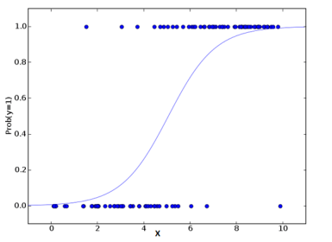
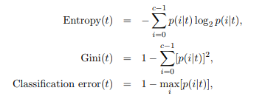
A bit about both Methods
Binomial LR Algorithm
Tree Based ML Algorithm
Dependent Variable – Dichotomous from Binomial Distribution
Relates Log of Odds to a Linear Combination of Predictors
Final model have statistically significant predictors
Dependent Variable – Dichotomous from Binomial Distribution
The goal is to form child nodes so that the node impurity is reduced
The higher the difference in impurity between parent and child nodes, the better the split.
Example : Class with p(event)=0.5 is most impure while Class with p(event)=100 is the most pure
Predicted Probabilities Describe a Sigmoidal Curve
Impurity Measures for C Classes in Target Variable

Slide 9


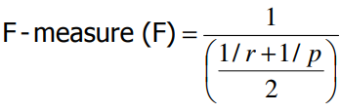
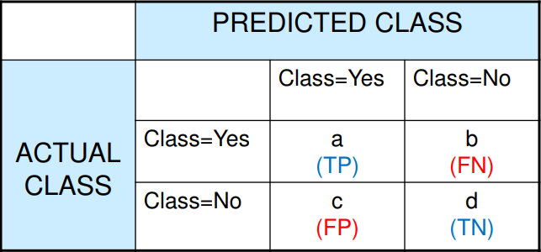


How to Measure Classification Performance
Accuracy
Precision
Recall
F Score
Confusion Matrix

Slide 10

THANK YOU!
Aritra Kumar Sinha
Phone
+91 9650444155
Email
aritrakumar.sinha@gmail.com

